Slide 1


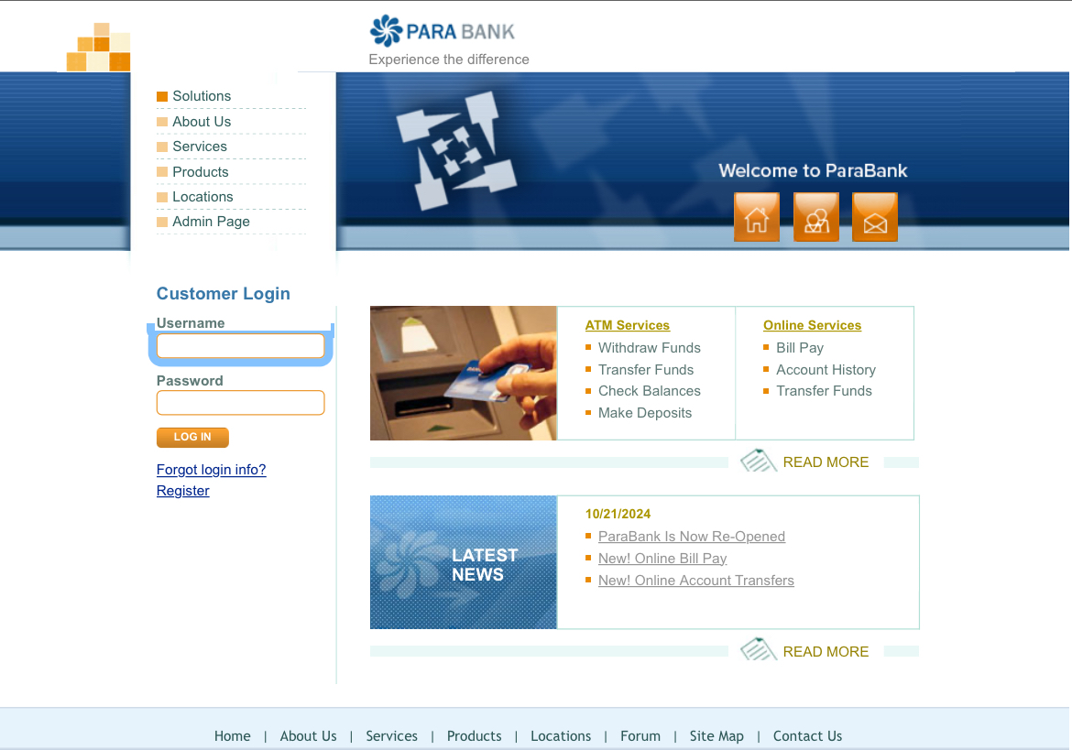
Software Testing Track
Automated Testing ParaBank website
This presentation explores the automated testing E2E scenario for ParaBank website, a web application simulating online banking functionality. The presentation will cover essential functionalities such as user registration, account management, and financial transactions.

Slide 2
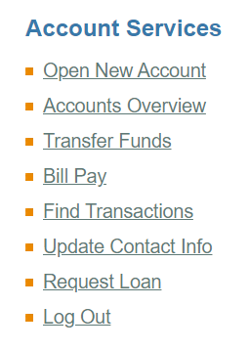
Software Testing Track
Account Services

Slide 3
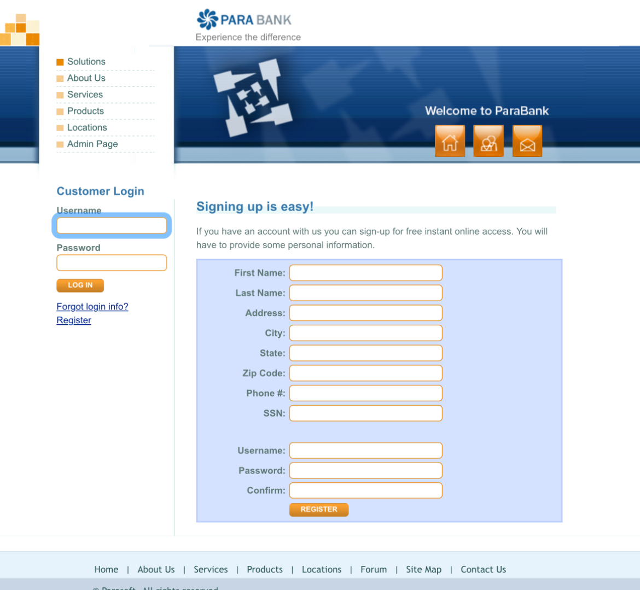
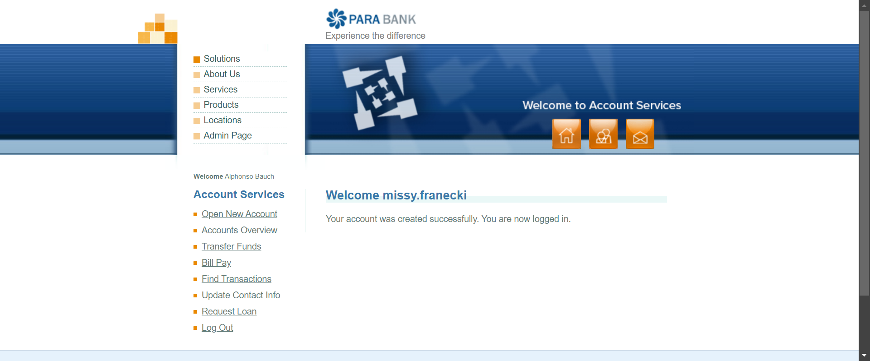
Software Testing Track
User Registeration

Slide 4
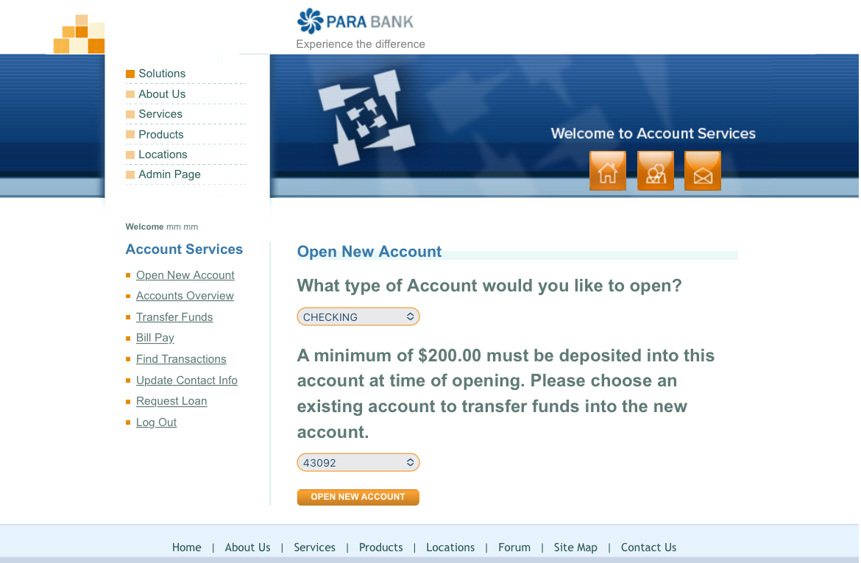
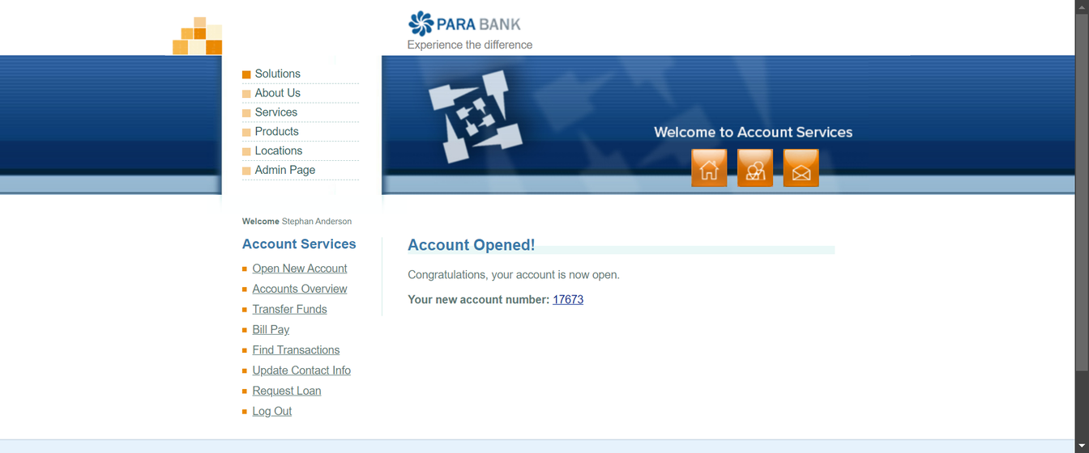
Software Testing Track
Open New Account

Slide 5
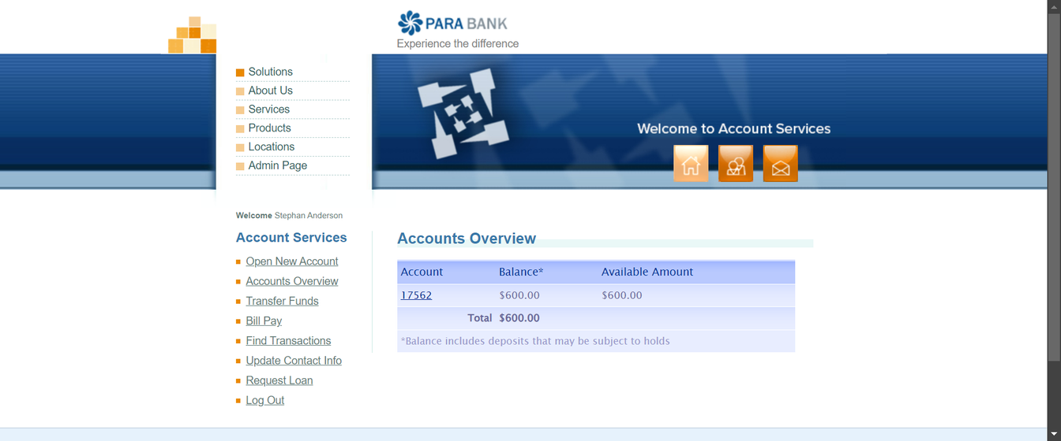
Software Testing Track
Account Overview

Slide 6
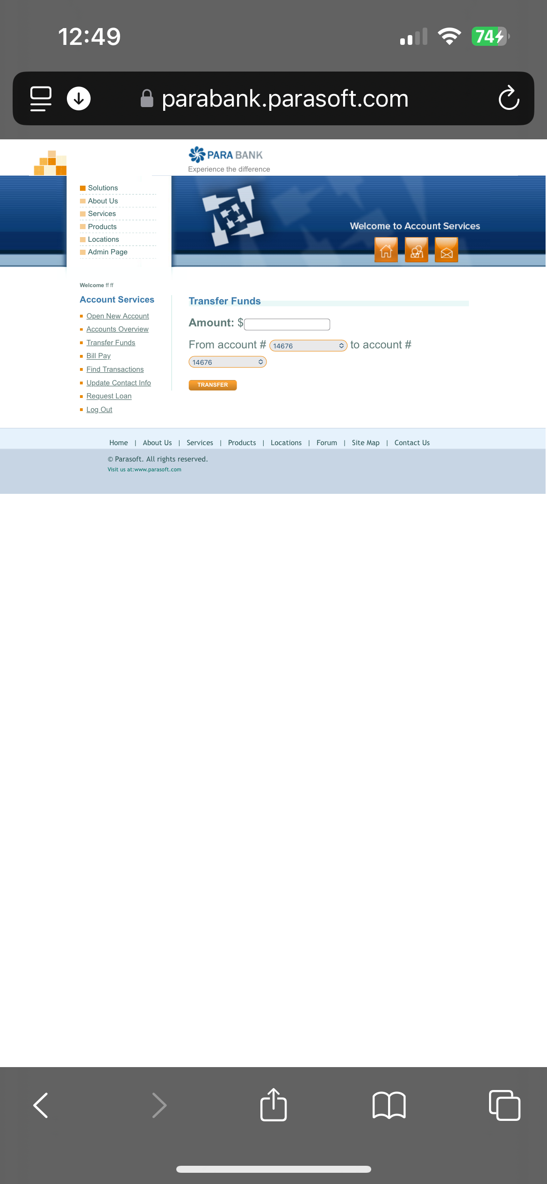
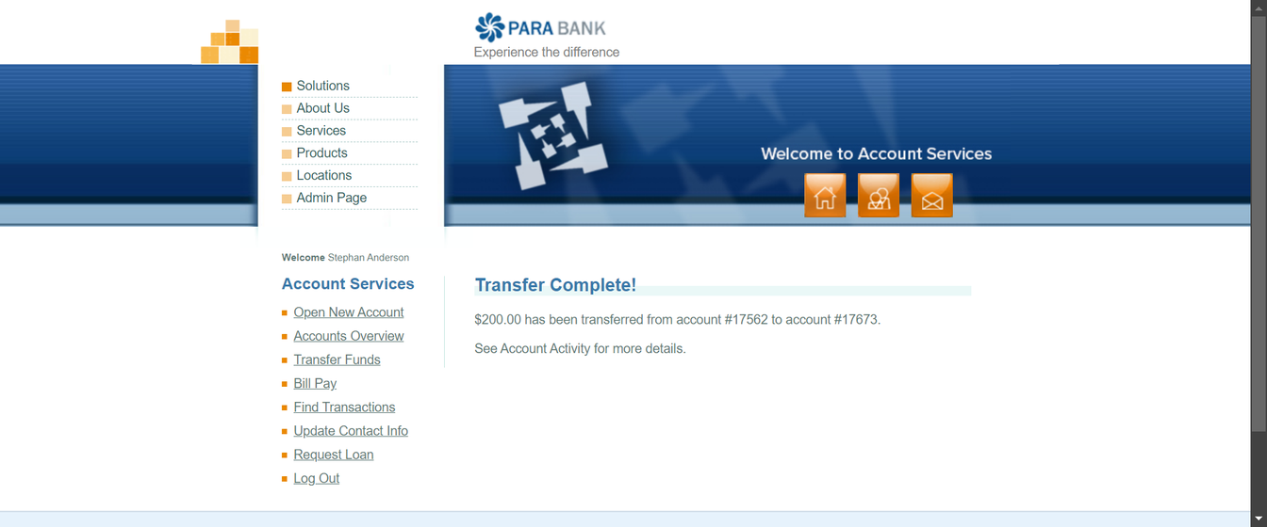
Software Testing Track
Transfer Funds

Slide 7
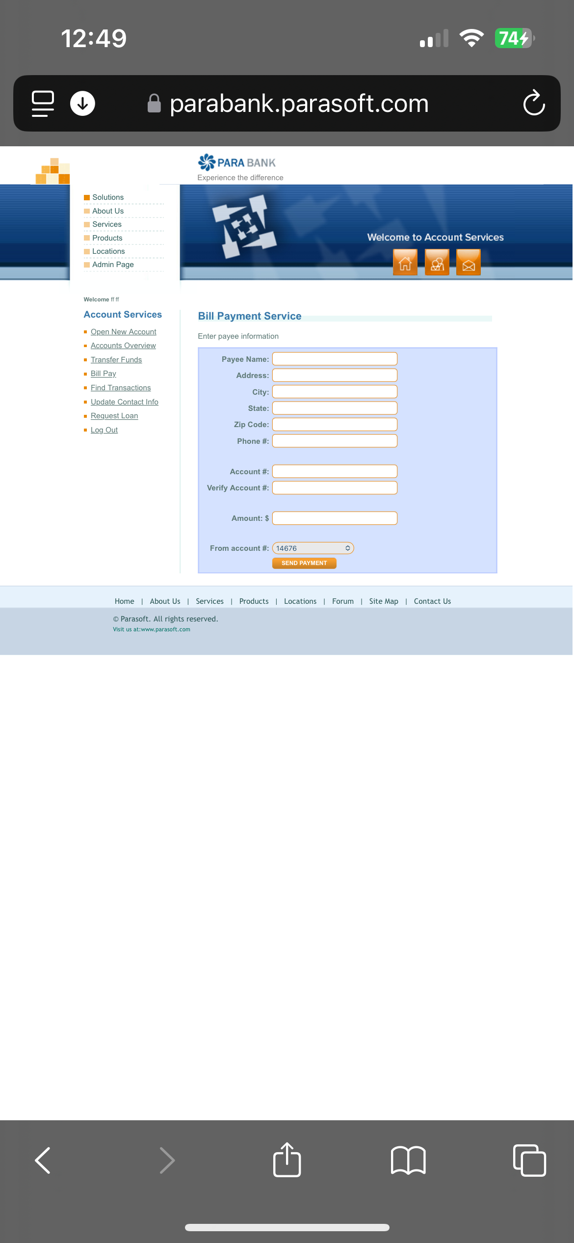
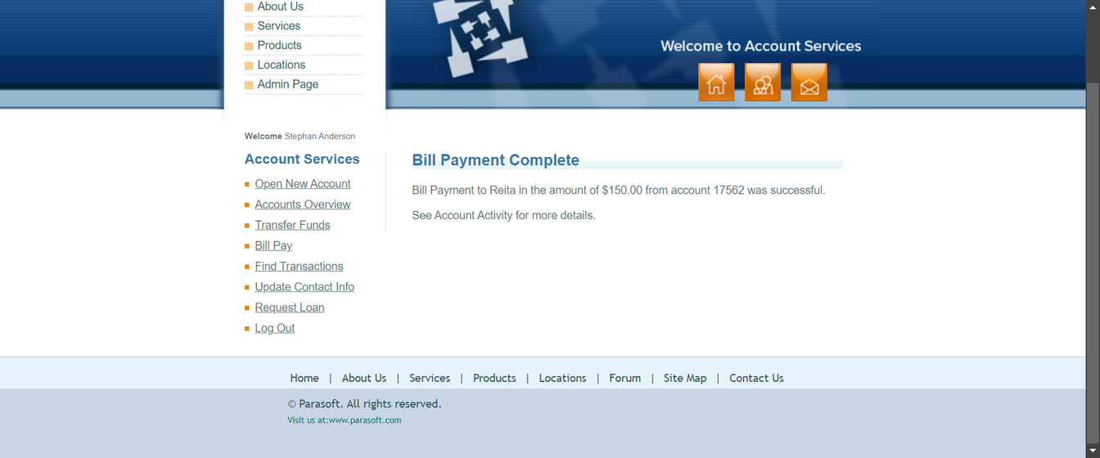
Software Testing Track
Bill Pay

Slide 8
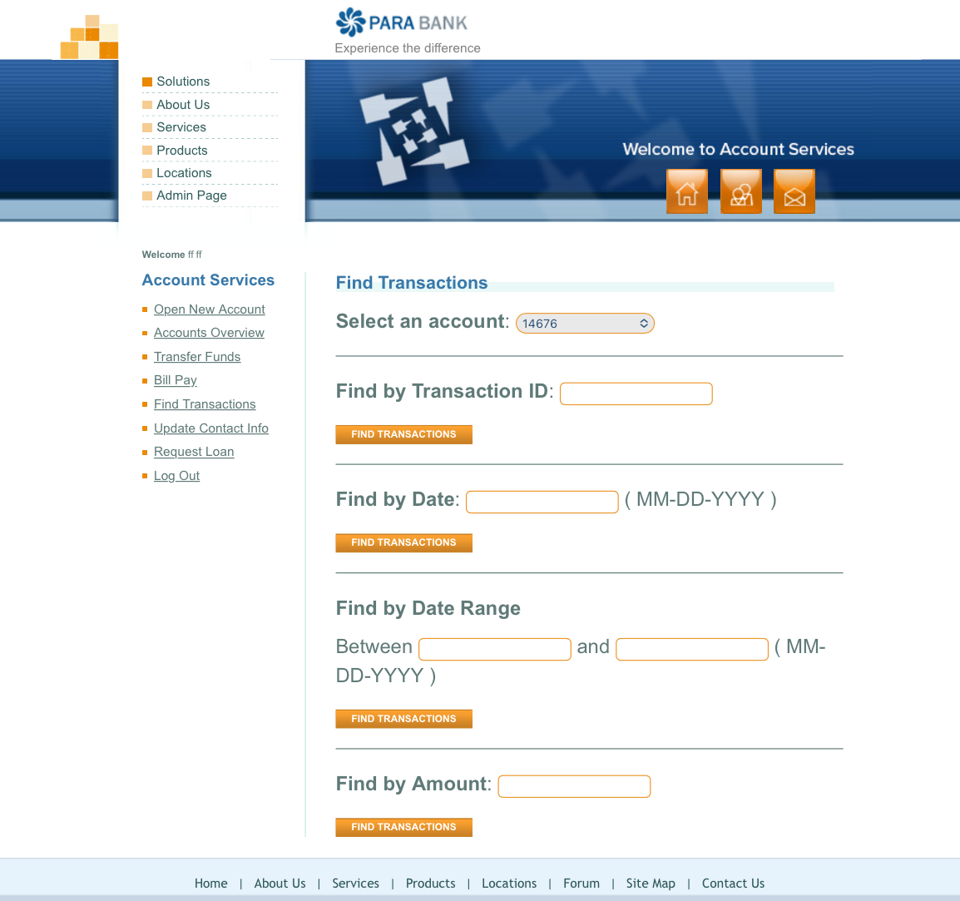
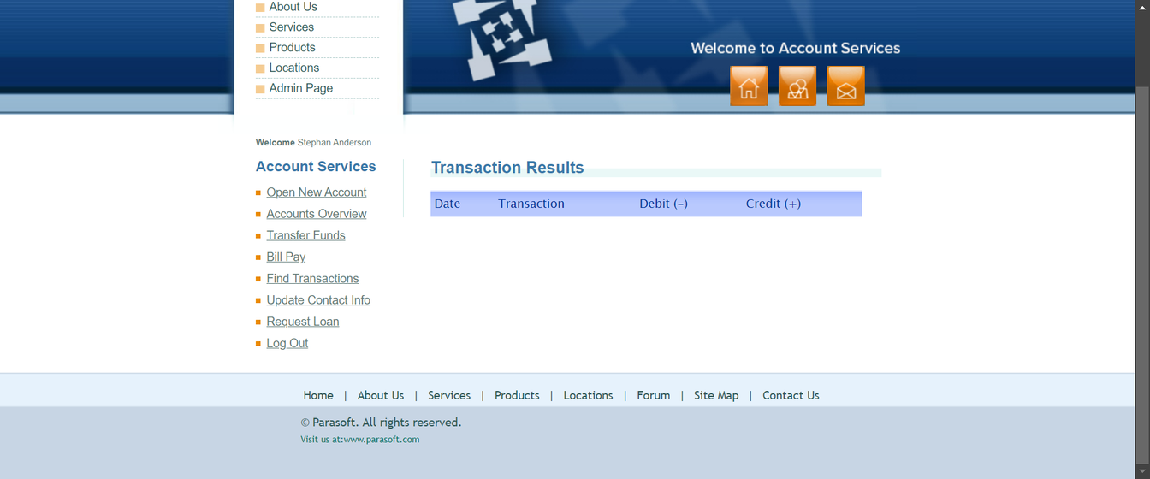
Software Testing Track
Find Transaction

Slide 9
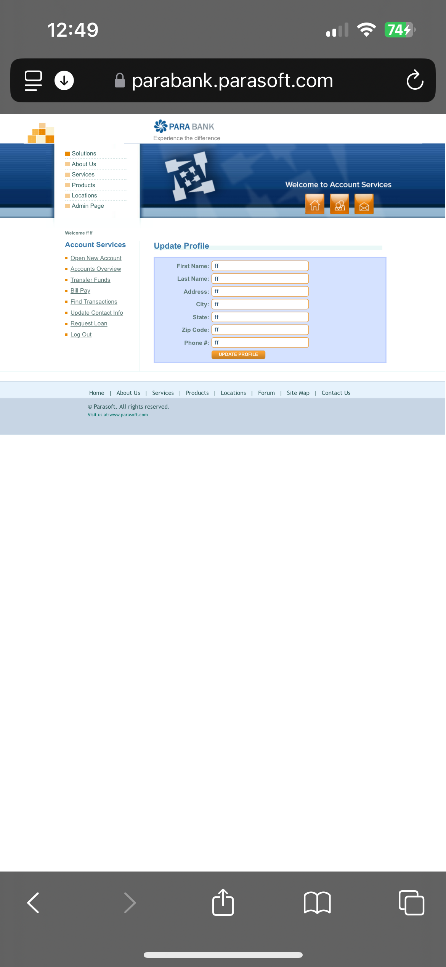

Software Testing Track
Update Contact Info

Slide 10
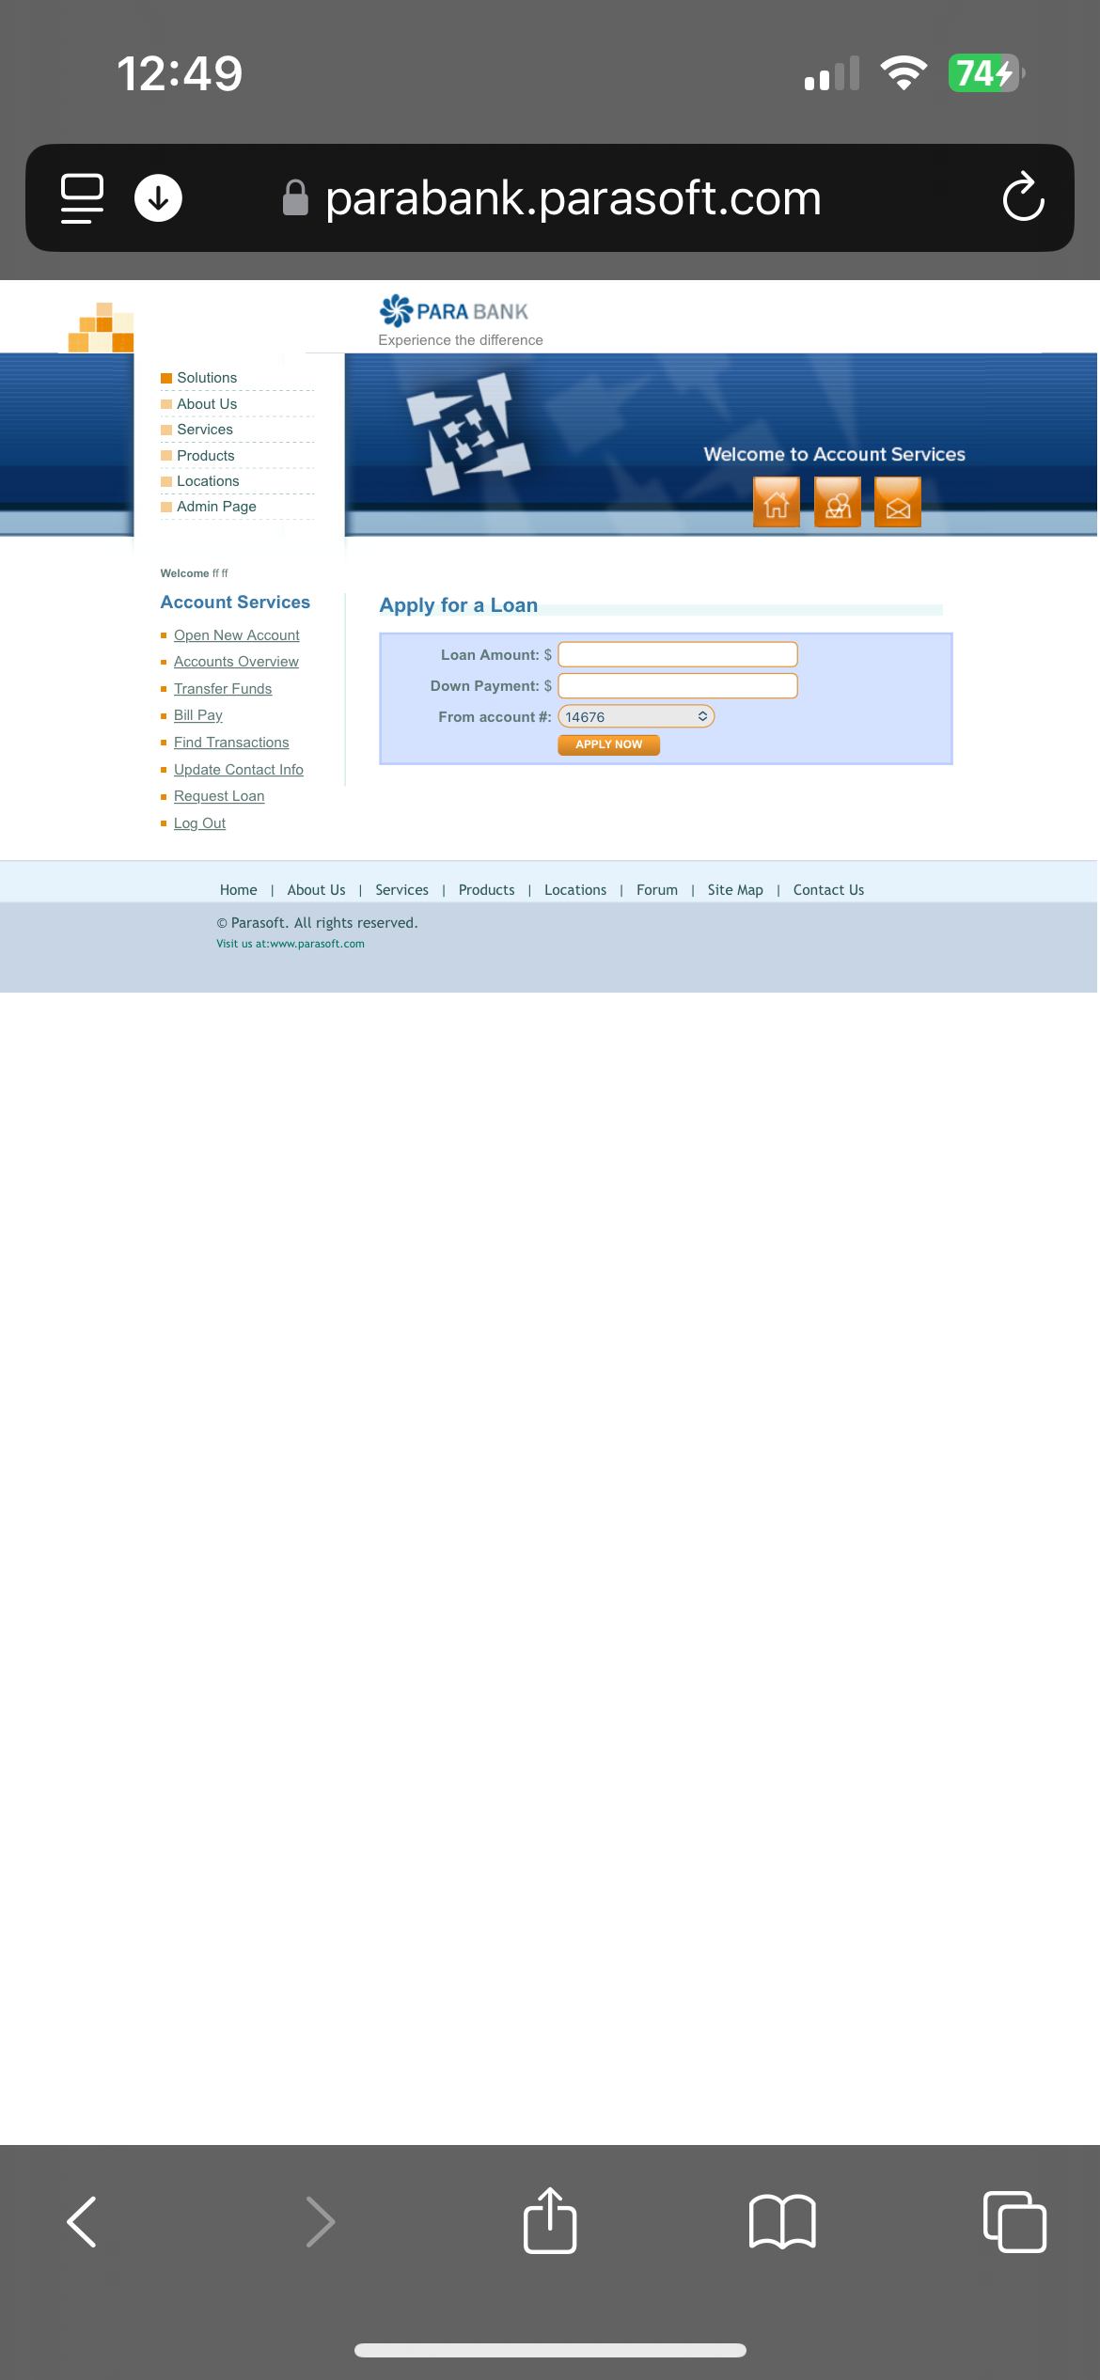
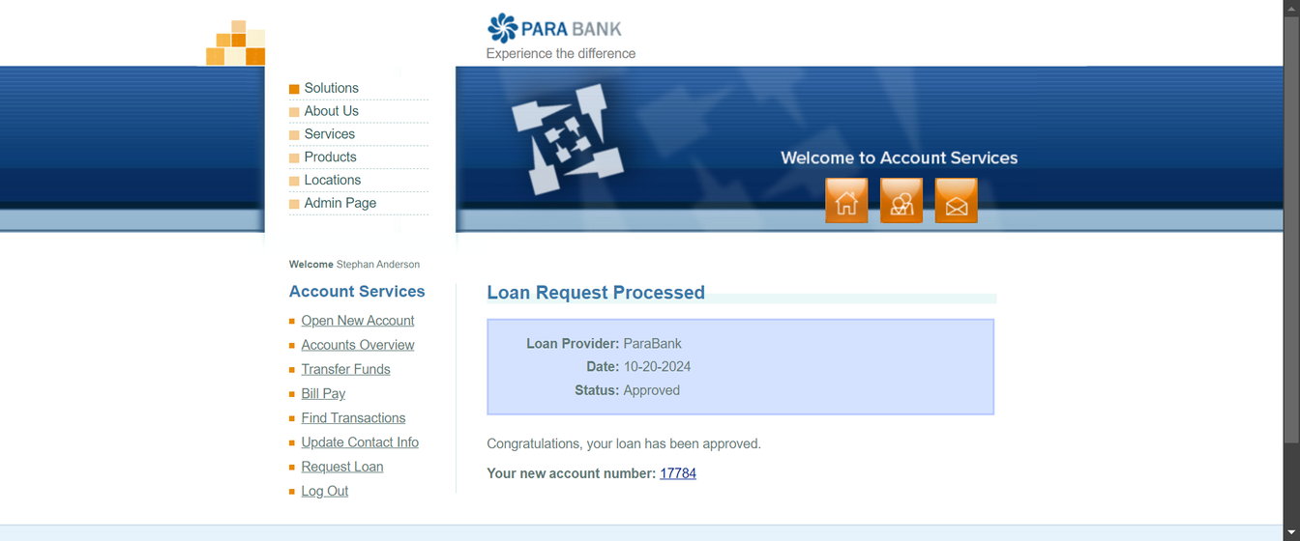
Software Testing Track
Request Loan

Slide 11
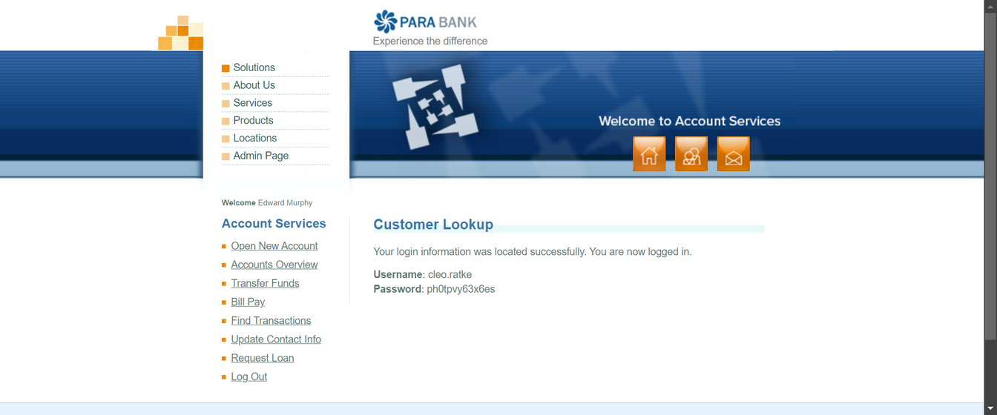

Software Testing Track
Forgot login info

Slide 12
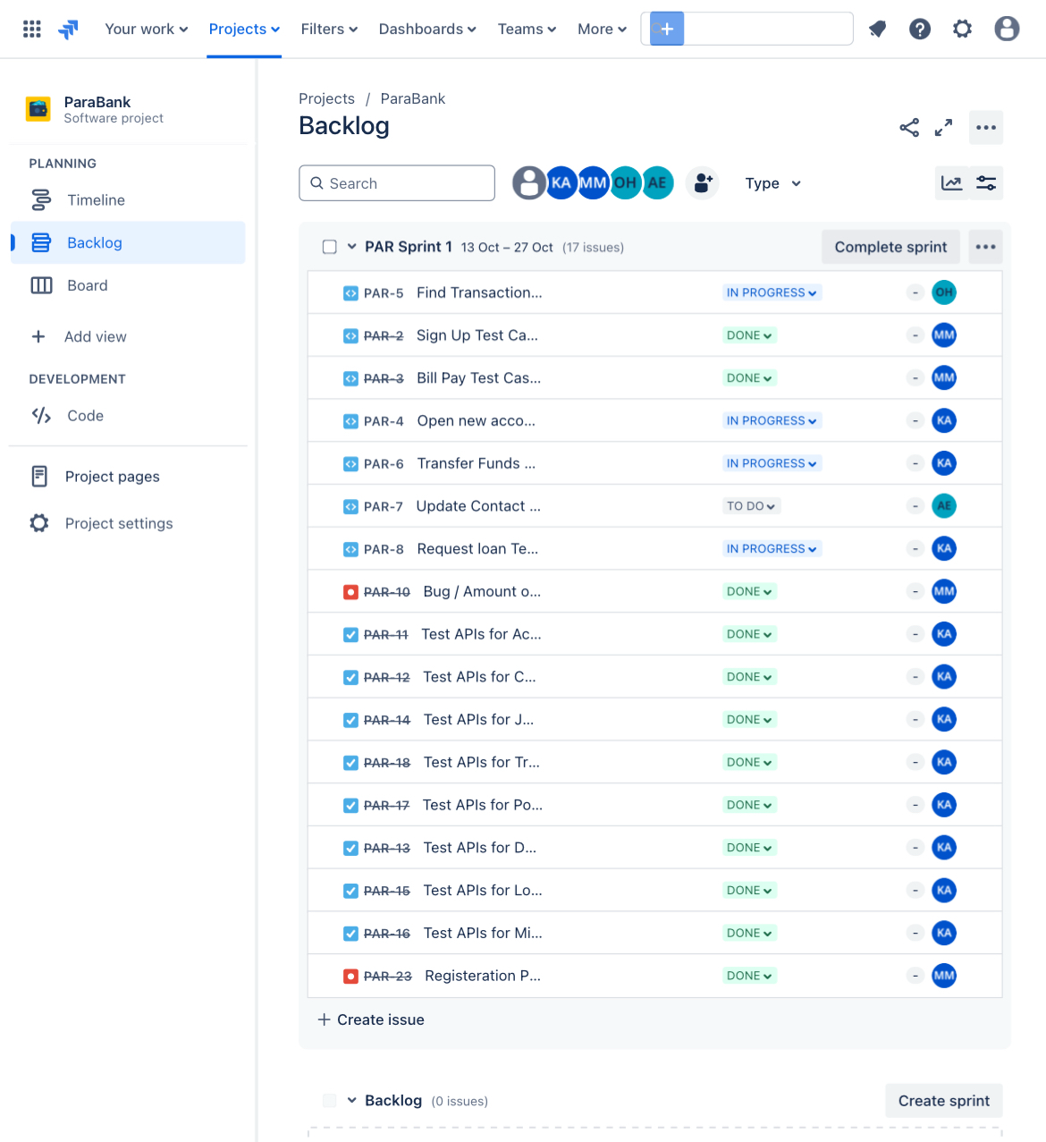
Software Testing Track
Jira Tool
Is a Mangment too
Analyzing Bugs
Test cases
API Tests

Slide 13
Software Testing Track
API using Postman
Purpose: Validate the behavior, functionality, and reliability of web services by sending requests to the API endpoints and analyzing the responses.
Postman Features Used:
Request Types: GET, POST, PUT, DELETE for testing different API operations.
Assertions: Validate status codes, response times, and data in the response body.
Collections: Organized API test cases for features like Sign Up, Bill Pay, and Transfer Funds.
Environment Variables: Dynamic data handling across different environments (e.g., dev, test).
Chaining Requests: Use of one request's output as the input for another to simulate real workflows.
Benefits:
Automates API testing, ensuring reliability.
Efficiently identifies issues in API responses before integration.
Provides quick feedback with detailed logs and reports.

Slide 14
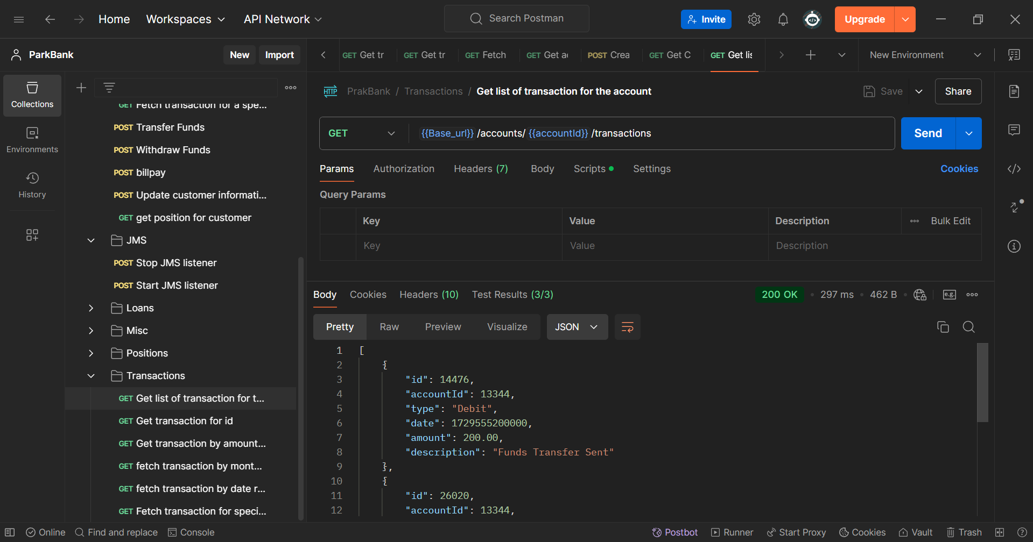
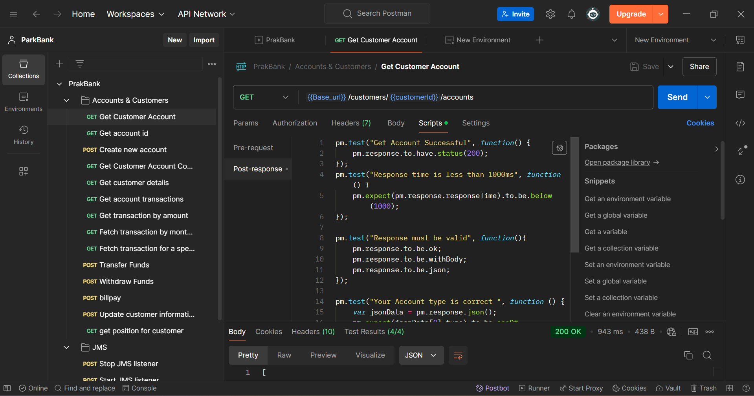
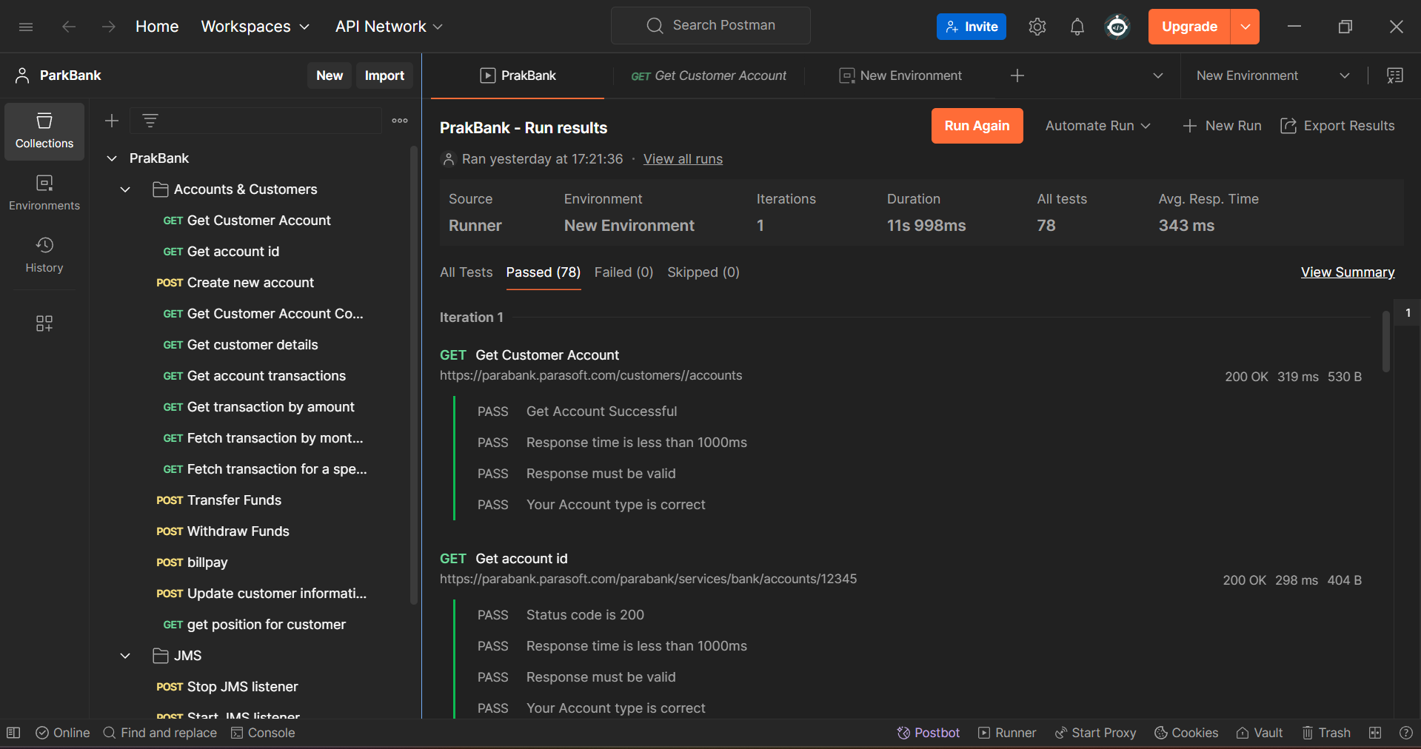
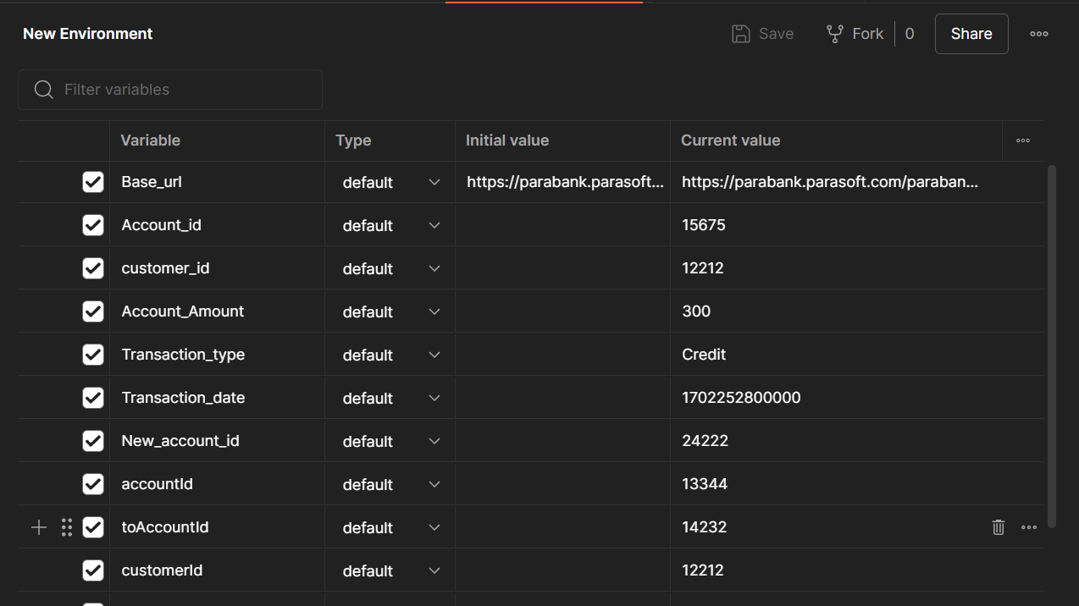
Software Testing Track

Slide 15


Software Testing Track
Thank you!

